Slide 1
Exercise 2:
Standardizing Data Using Ontology Look-up Services

Slide 2
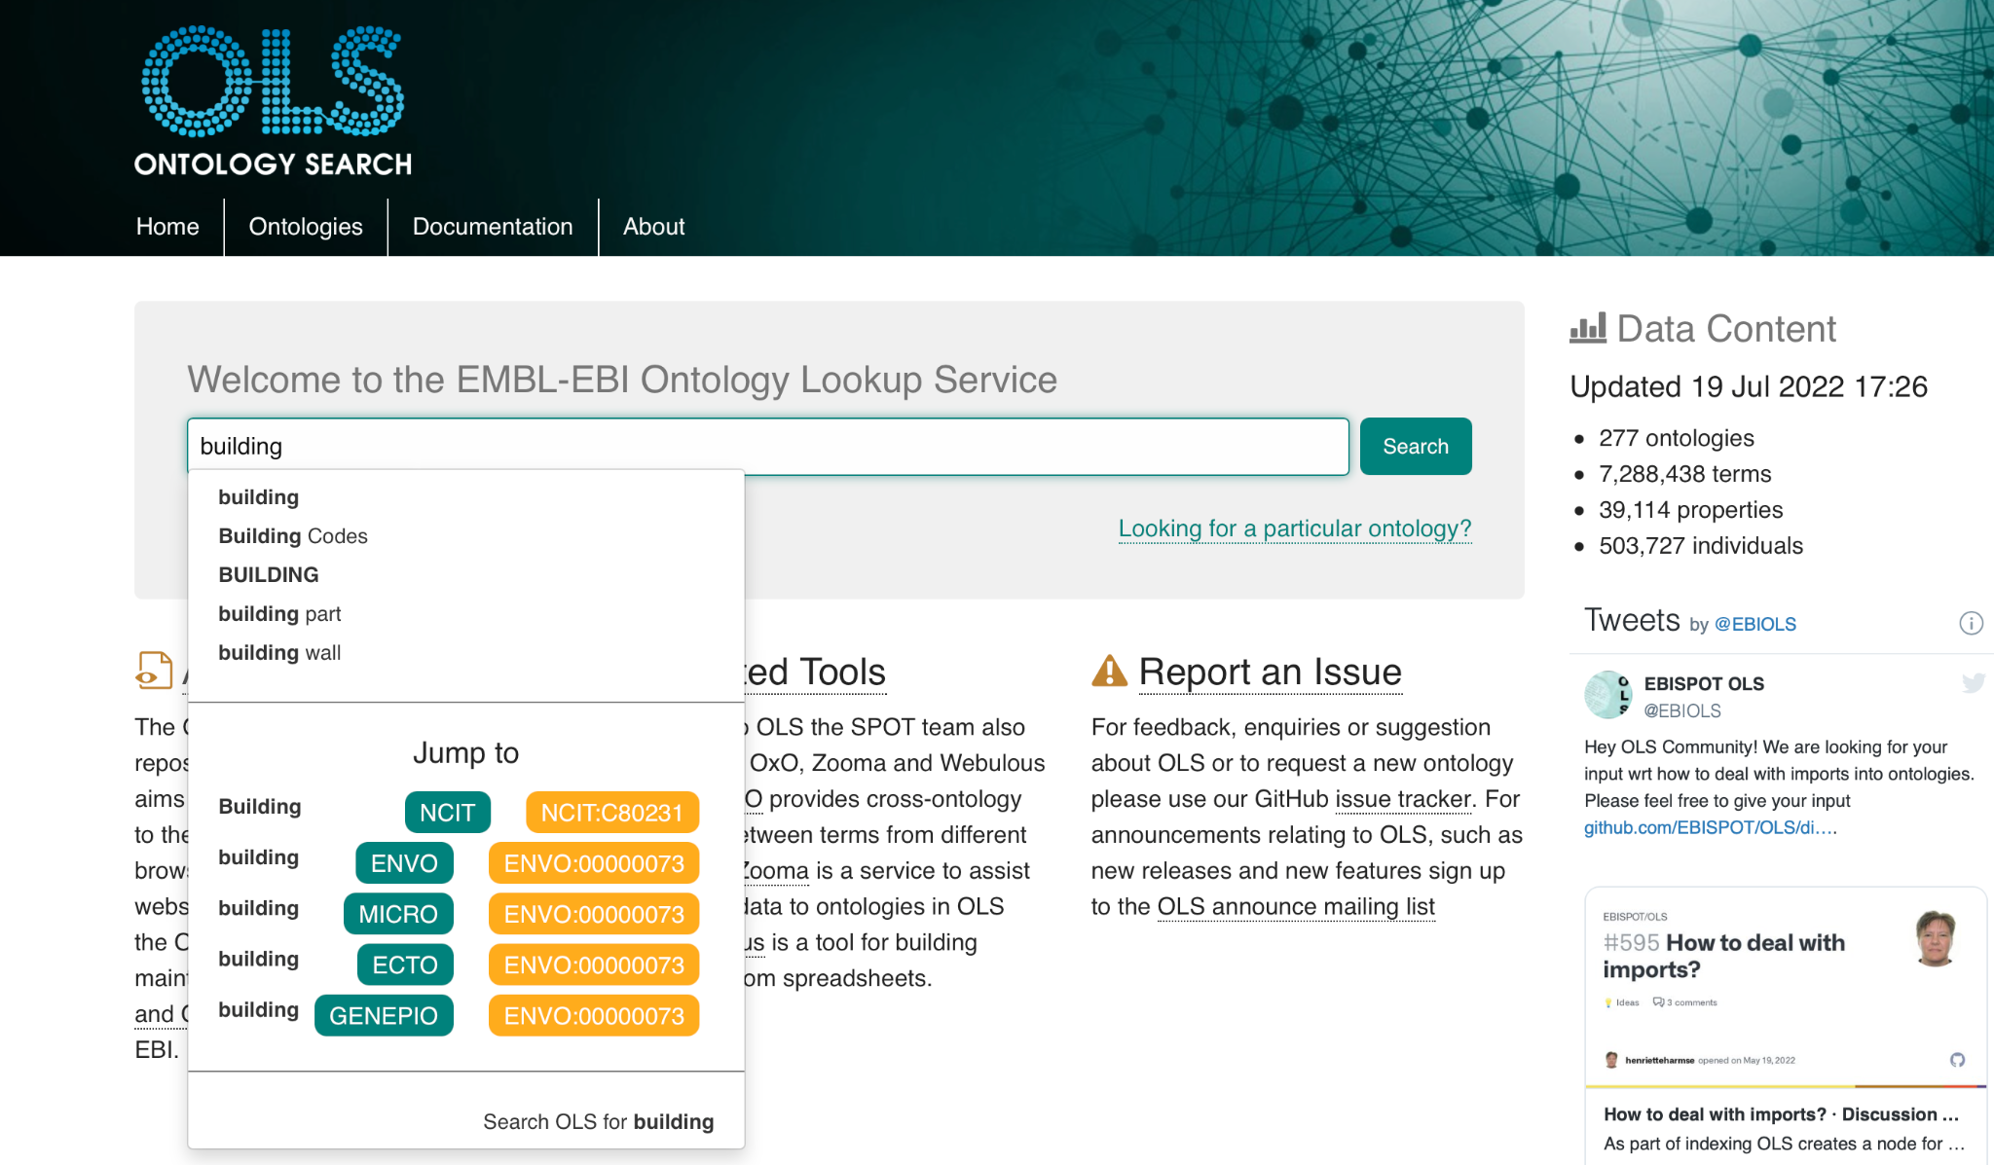
How to find ontology terms
https://www.ebi.ac.uk/ols/
Notes:
OntoBee: He Group, U of M Medical School
OLS: European Bioinformatics Institute, https://www.ebi.ac.uk/ols/
BioPortal : The National Centre for Biomedical Ontology
Agroportal: The Laboratory of Informatics, Robotics and Microelectronics of Montpellier
EMBL-EBI OLS Demo: https://osf.io/ye39g

Slide 3
So you’re shopping for ontology terms: How to evaluate term matches
Searches for terms can yield many/different kinds of results. To evaluate the matches, ask yourself the following:
Does the match sound like what I’m looking for?
Is it a synonym, e.g. rocketship vs spaceship
Is it being defined by an ontology that makes sense with my use case?
A disease ontology is more appropriate for disease terms vs mouse model ontology
Does the definition sound right?
“Cell” could be room in a jail OR a basic unit of life
Is it specific enough? Too specific?
Cough vs productive cough vs productive cough (green sputum))
Is it reused in many different ontologies?
Hint: keep evaluating matches past the first hit

Slide 4
Who do you trust? Evaluating ontologies…
All ontologies are not created equal. Ontologies can be built for specific project.
Advice for choosing ontologies to use:
Should be under active development (updated)
Should accept term requests from the community and respond in a timely manner
Should be interoperable and adhere to best practices (e.g. OBO Foundry)
The more widely used the better
Should provide definitions and sources

Slide 5
Who do you trust? Evaluating ontologies…
Get advice. Chat with people. Some of our recommendations:
UO - units
NCBITaxon - taxonomy
ENVO - environment (built & natural)
OBI - assays, biological processes
FoodOn - food
DO - diseases
HP - symptoms
Uberon - anatomy
ChEBI - chemicals/drugs
GAZ - geography

Slide 6
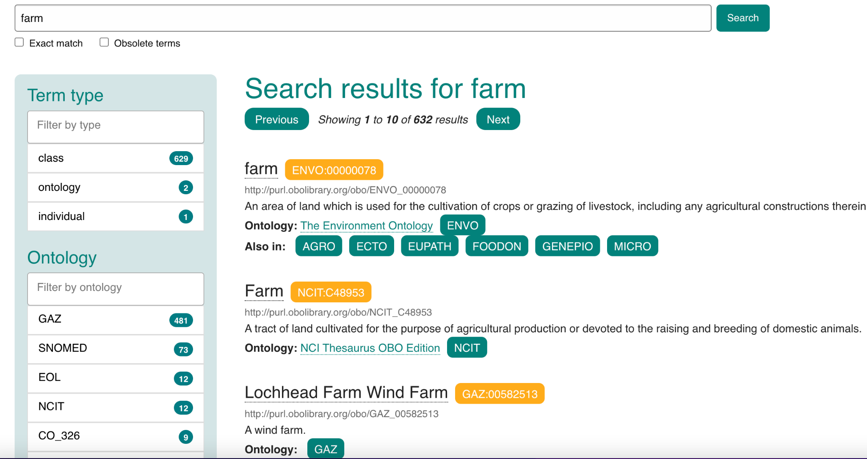
So you’re shopping for ontology terms: How to evaluate term matches
Example: farm
“Farm” is exact match!
Def sounds right
ENVO (Environment) >
NCIT=Cancer
ENVO term in multiple ontologies
Conclusion:
select
Farm [ENVO:00000078]

Slide 7
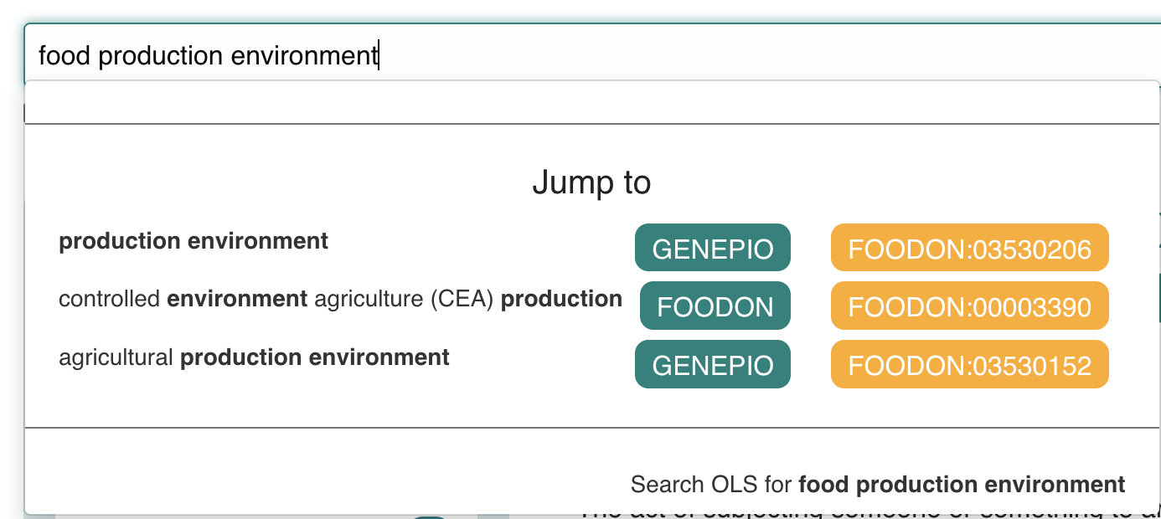
So you’re shopping for ontology terms: How to evaluate term matches
Example: food production environment
No exact matches
Try a synonym

Slide 8
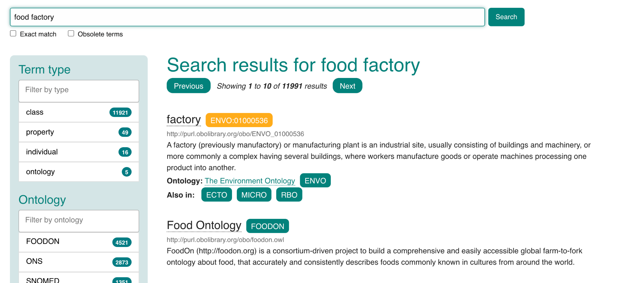
So you’re shopping for ontology terms: How to evaluate term matches
Example: food production environment
No exact matches for
“food factory”
Re-examine “production environment” matches

Slide 9
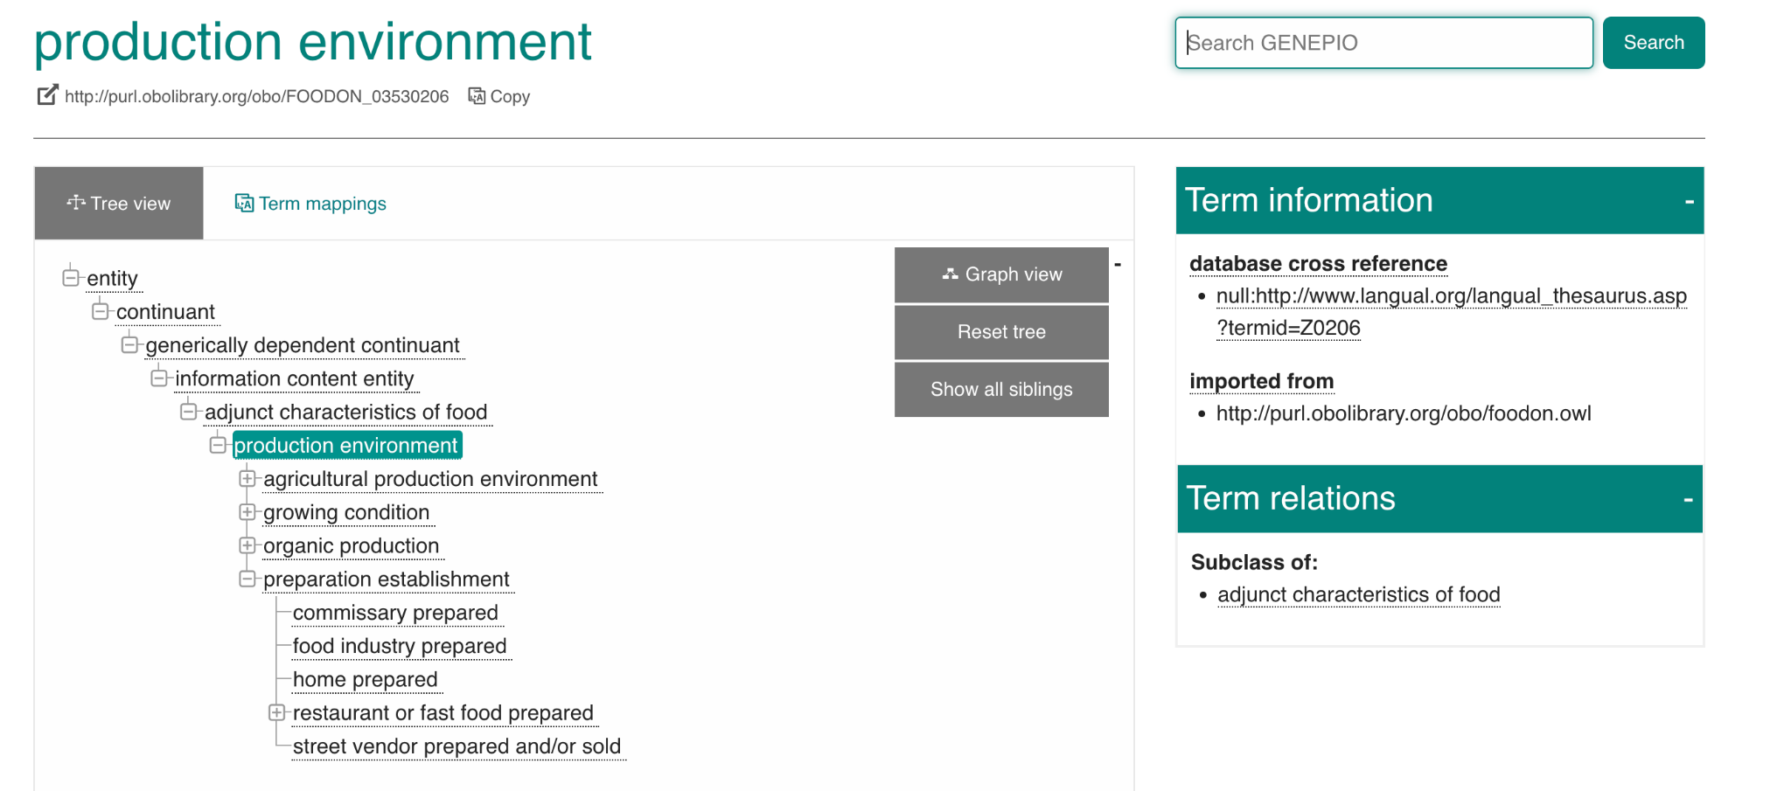
So you’re shopping for ontology terms: How to evaluate term matches
Example: food production environment
“Preparation establishment” is close, but not quite right
Conclusion:
Need new term
Make new term request
Ontologies are living lexicons → need to reflect community needs

Slide 10
Standardization Exercise
Navigate to: https://www.ebi.ac.uk/ols/index
Try searching:
Province/state you are from
Your favourite food
A thing you can see from your window
“Cordyceps” from The Last of Us
Record terms on paper/text editor in format:
Label [ontology:ID]
e.g. pizza [FOODON:00003928]

